Slide 1
IILM UNIVERSITY
G R E A T E R N O I D A
Internship Presentation
Virtual Logistics Data Analysis Intern
Submitted By: Ayush Bhati
Program: B.Tech (Computer Science & Engineering), 5th Semester
Organization: Yuvaintern
Duration: 13/08/2026 – 10/09/2026 (4 Weeks)

Slide 2
About the Organization
YuvaIntern is a virtual internship platform that helps students and freshers gain practical industry experience through real-world projects and tasks. It provides internship opportunities in various fields such as Data Analytics, Technology, Finance, Marketing, HR, Logistics, and Design. The organization focuses on developing students’ practical skills, improving their professional knowledge, and preparing them for future career opportunities.
Internship Snapshot
4
Weeks Duration
Virtual
Mode of Internship
Python
Core Domain
Yuvaintern
Host Organization

Slide 3
Objectives of the Internship
1
Practical Exposure
Core Concepts
Strengthen understanding of data structures, control flow, functions, and OOP.
2
Gain hands-on experience in Python programming beyond classroom learning.
3
Build Projects
Problem Solving
Improve debugging, logical reasoning, and independent work skills.
4
Develop small, functional Python applications as part of guided tasks.

Slide 4


Learning Outcomes
Stronger command over Python syntax and applied programming
Improved ability to break problems into manageable components Systematic debugging and error-resolution skills
Independent time and deliverable management in a remote setting Greater confidence to take on new programming challenges

Slide 5
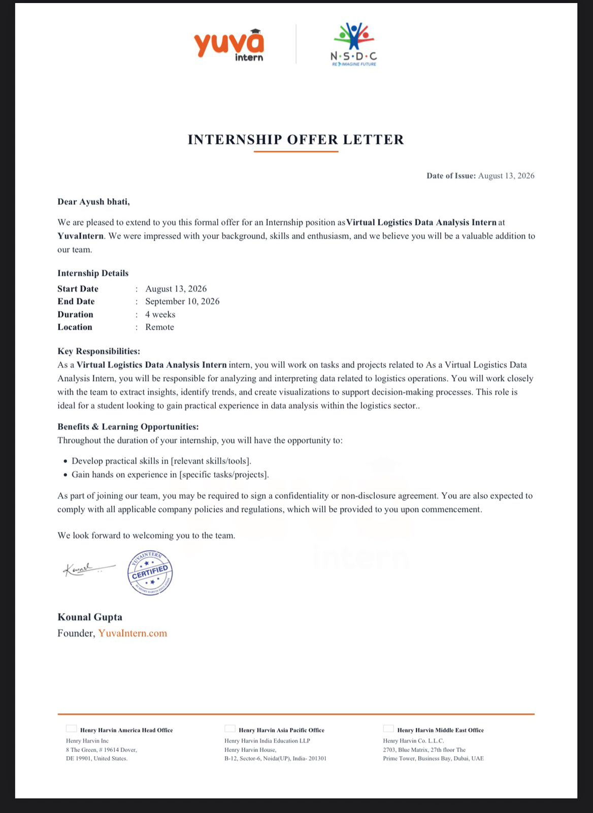
Certificate of Completion

Slide 6
Conclusion
The four-week virtual internship in Virtual Logistics Data Analysis Intern at Yuvaintern strengthened both technical proficiency and problem-solving ability, translating classroom knowledge into practical, hands-on skills.
This experience has laid a strong foundation for future academic and professional pursuits in computer science and software development, complementing the ongoing B.Tech (CSE) program at IILM University, Greater Noida.
Thank You

